Slide 1

TensorFlow 2.0
PRACTICAL

Slide 2
PROJECT #5 OVERVIEW

Slide 3

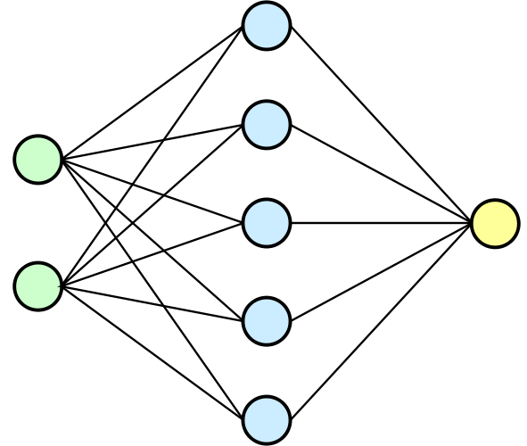
PROJECT #5: TEXT CLASSIFICATION AND SENTIMENT ANALYSIS
Dataset consists of 3000 Amazon customer reviews, star ratings, date of review, variant and feedback of various amazon Alexa products like Alexa Echo, Echo dots.
The objective is to discover insights into consumer reviews and perform sentiment analysis on the data.
Dataset: www.kaggle.com/sid321axn/amazon-alexa-reviews
TRAINED ARTIFICIAL NEURAL NETWORK MODEL
REVIEW (TEXT)
VARIANT
POSITIVE
OR NEGATIVE REVIEW
DATE
Photo Credit: https://commons.wikimedia.org/wiki/File:Neural_network.svg
TensorFlow 2.0 PRACTICAL

Slide 4
TOKENIZATION (COUNT VECTORIZER)

Slide 5
PROJECT #5: TOKENIZATION (COUNT VECTORIZER)
This is the first document.
This document is the second document.
And this is the third one.
Is this the first document?
[[0 1 1 1 0 0 1 0 1]
[0 2 0 1 0 1 1 0 1]
[1 0 0 1 1 0 1 1 1]
[0 1 1 1 0 0 1 0 1]]
 | 'and' | 'document' | 'first' | 'is' | 'one' | 'second' | 'the' | 'third' | 'this'
Training Sample #1 | 0 | 1 | 1 | 1 | 0 | 0 | 1 | 0 | 1
Training Sample #2 | 0 | 2 | 0 | 1 | 0 | 1 | 1 | 0 | 1
Training Sample #3 | 1 | 0 | 0 | 1 | 1 | 0 | 1 | 1 | 1
Training Sample #4 | 0 | 1 | 1 | 1 | 0 | 0 | 1 | 0 | 1
TensorFlow 2.0 PRACTICAL

Slide 6

CONFUSION MATRIX

Slide 7
PROJECT #5: CONFUSION MATRIX
TRUE CLASS
+
-
TYPE I ERROR
+
TRUE +
FALSE +
PREDICTIONS
FALSE -
TRUE -
-
TYPE II ERROR

Slide 8
PROJECT #5: CONFUSION MATRIX
A confusion matrix is used to describe the performance of a classiﬁcation model:
True positives (TP): cases when classiﬁer predicted TRUE (they have the disease), and correct class was TRUE (patient has disease).
True negatives (TN): cases when model predicted FALSE (no disease), and correct class was FALSE (patient do not have disease).
False positives (FP) (Type I error): classiﬁer predicted TRUE, but correct class was FALSE (patient did not have disease).
False negatives (FN) (Type II error): classiﬁer predicted FALSE (patient do not have disease), but they actually do have the disease

Slide 9
PROJECT #5: KEY PERFORMANCE INDICATORS (KPI)
Classiﬁcation Accuracy = (TP+TN) / (TP + TN + FP + FN)
Misclassiﬁcation rate (Error Rate) = (FP + FN) / (TP + TN + FP + FN)
Precision = TP/Total TRUE Predictions = TP/ (TP+FP) (When model predicted TRUE class, how often was it right?)
Recall = TP/ Actual TRUE = TP/ (TP+FN) (when the class was actually TRUE, how often did the classiﬁer get it right?)

Slide 10
PROJECT #5: PRECISION Vs. RECALL EXAMPLE
TRUE CLASS
+
-
Total # data points = 100
# Cancer Patients = 9
# Healthy Patients = 91
TP = 1
FP = 1
+
PREDICTIONS
-
FN = 8
TN = 90
Classiﬁcation Accuracy = (TP+TN) / (TP + TN + FP + FN) = 91%
Precision = TP/Total TRUE Predictions = TP/ (TP+FP) = ½=50%
Recall = TP/ Actual TRUE = TP/ (TP+FN) = 1/9 = 11%

